Slide 1
I produced the following PowerPoint presentation in about ten minutes, taking advantage of the free service offered by Tome.app
Therefore, in addition to the economics that revolves around this topic, which I have been passionate about for decades now, I wanted to give proof of how AI nowadays can be extremely useful if slides need to be presented during office meetings, conferences with data projection, presentations in university classrooms, online calls, webinars, etc.

Slide 2
THE ECONOMICS BEHIND THE ANIME INDUSTRY

Slide 3

Introduction
Anime is a beloved form of entertainment enjoyed by millions around the world.
However, many fans may not realize the high costs associated with producing these shows.
In Japan, where the anime industry is thriving, understanding the economics behind anime production is crucial for fans, creators, and industry professionals alike.
In this presentation, we will explore the different stages of anime production, the rising costs of production in Japan, and the impact this has on the anime industry as a whole. By gaining a deeper understanding of the costs involved in creating anime, we can better appreciate the hard work and dedication that goes into making our favorite shows.

Slide 4

What Goes Into Anime Production?
Anime production involves a number of stages, each with its own set of expenses. The first stage is pre-production, which includes planning, storyboarding, and character design. During this stage, the production team determines the look and feel of the anime, creates a script, and designs the characters that will appear in the show.
The next stage is production, where the actual animation takes place. This involves drawing the frames of the animation, coloring them, and adding special effects. It can take hundreds or even thousands of drawings to create just one minute of animation. Finally, post-production involves editing, sound design, and adding music to the finished product.

Slide 5

The Rising Costs of Anime Production
Over the past decade, the costs of producing anime in Japan have skyrocketed. One major factor contributing to this rise is the increasing demand for high-quality animation. Fans now expect more detailed, intricate visuals than ever before, which requires a greater investment of time and resources from studios.
Another key factor is the rising cost of labor in Japan. As the country's population ages and younger generations prioritize work-life balance, finding skilled animators willing to work long hours for relatively low pay has become increasingly difficult. This has forced studios to offer higher salaries and benefits packages, driving up production costs even further.

Slide 6

The Economics of Anime Production
Anime production companies make money through a variety of revenue streams. One of the main sources of revenue is from licensing the rights to broadcast or stream their shows. This can be done domestically in Japan or internationally in countries such as the United States and China. Another source of revenue is from selling merchandise related to the anime, such as figurines, clothing, and video games. Additionally, some anime production companies have
their own online stores where fans can purchase exclusive merchandise. When it comes to balancing the costs of
production with revenue, anime production companies
must carefully consider their budget for each show.
They must take into account expenses such as salaries
for staff, voice actors, and animators, as well as the cost
of renting studio space and equipment. To make sure they
stay within budget, many production companies use a
system called crowdfunding, where fans can donate money
to help fund the production of a show.
This not only helps with funding but also serves as a way to
gauge interest in the show before it is produced.

Slide 7

The Production Costs of Anime Series
The production costs of a Japanese animation product are complex to estimate. According to an article reported in 2023 in the Weekly Toyo Kaisen magazine, a single animated episode would on average cost 31,2 million yen (around 208,000 euros). Naturally there are low budget works as well as extremely detailed works where no expense is spared: this analysis takes into account, on average, the cost of a single episode of a classic animated season consisting of 12 episodes, considering the single episode as a television block lasting 30 minutes (including advertising). A 12-episode animated series would therefore cost approximately 374,4 million yen (just under 2.5 million euros).

Slide 8
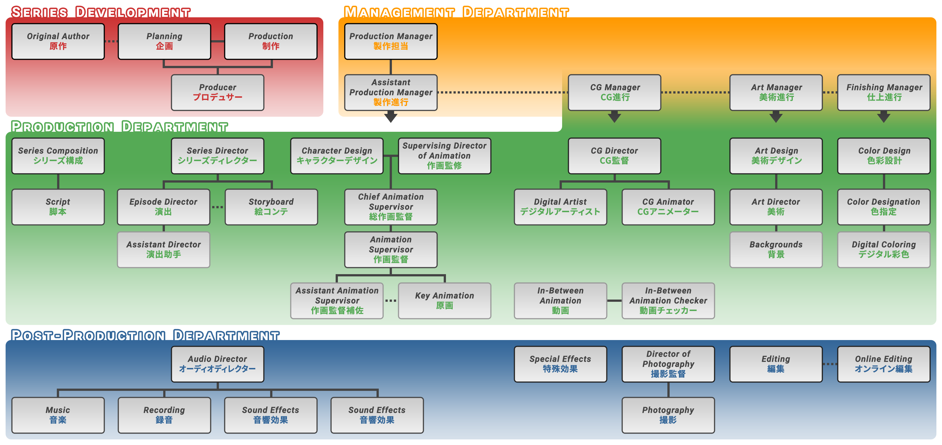
Team behind the production of an ANIME
However, it is essential to consider that, to have a good product, in addition to the production costs, there are those relating to the staff behind it. Below, there is a list of the main costs divided by type and the organizational chart to give an example of how elaborate the organizational scheme behind the production of an animated product can be.
- €12,000 production costs
- €20,000 management costs
- €20,000 animation management costs
- €16,000 management fee
- €1,600 costs of the screenplay/script
- €1,400 fee for using the original work
- €10,000 production process
- €60,000 cost for frames and layout
- €22,000 cost of animations and CG
- €17,000 audio/video editing
- €13,500 background design
- €6,000 coloring process
- €7,000 photography/special effects
- €2,500 production materials
- €20,000 administrative costs
SOURCE: KANZENSHUU.COM

Slide 9

The Impact on the Anime Industry
Rising anime production costs have had a significant impact on the industry, both in Japan and globally. While some anime productions have managed to thrive despite the increased expenses, others have struggled to break even or turn a profit.
This has led to a more cautious approach to anime production, with studios and producers carefully considering the financial risks involved before committing to new projects.
One major consequence of rising production costs is the increasing reliance on international markets to generate revenue. As Japanese audiences become more discerning and less likely to support every new anime release, producers are turning to overseas markets to make up for lost profits. This has led to a greater emphasis on creating content that will appeal to global audiences, rather than just domestic ones.

Slide 10

Conclusions
In conclusion, understanding the costs of anime production in Japan is crucial for fans, creators, and industry professionals. As we have seen, anime production involves a complex process with various stages, each with its own expenses. The rising costs of production have been driven by
factors such as increased competition, higher wages, and the need to meet audience expectations. Despite these challenges, anime production companies continue to find ways to balance their costs with revenue from merchandise, streaming, and other sources. However, the impact of rising production costs on the anime industry cannot be ignored.
Some productions have been successful in spite of high costs, while others have struggled to break even. As fans, it's important to support the anime we love, but also to understand the realities of the industry. By doing so, we can help ensure that anime continues to thrive for years to come.

